Slide 1



Airport Authority Data Analysis
View in Power BI
Last data refresh:
28.05.2023 22:27:17 UTC
Downloaded at:
06.01.2024 17:00:06 UTC

Slide 2
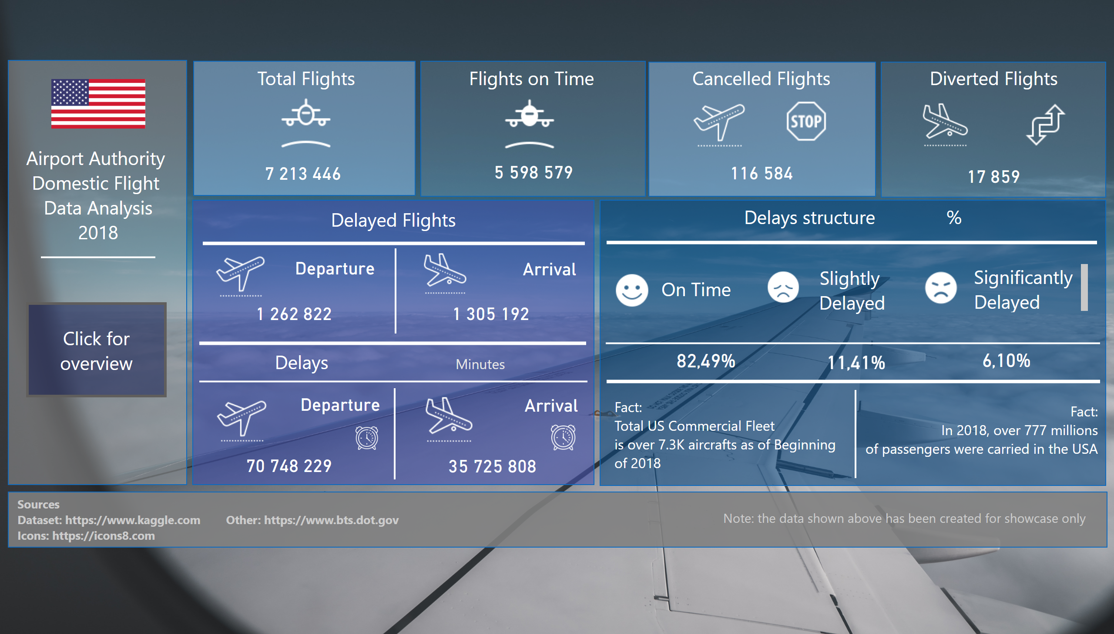
Main Page
Notes:
Main page of the project with general data.

Slide 3
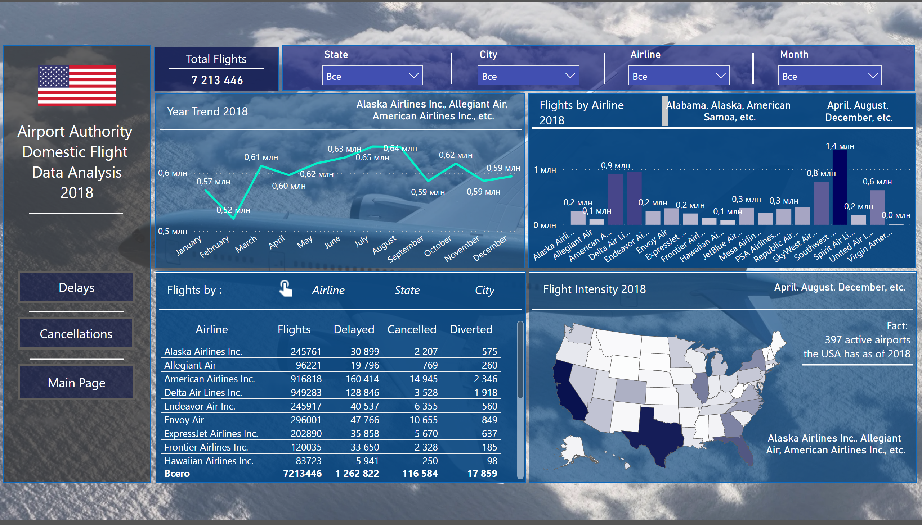
Flight Analisys
Notes:
Flights analysis page with visuals, synchronized slicers, bookmarks.

Slide 4
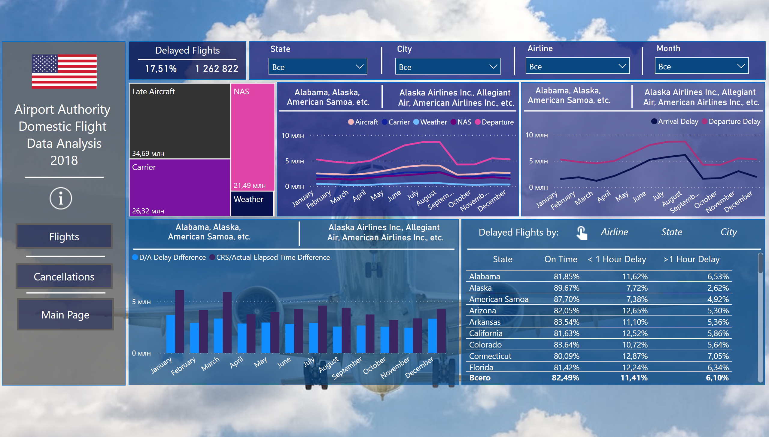
Delay Analysis
Notes:
Delays analysis of delay reasons via airlines, States, Cities and time of the Year with visuals, bookmarks and synchronized slicers.

Slide 5
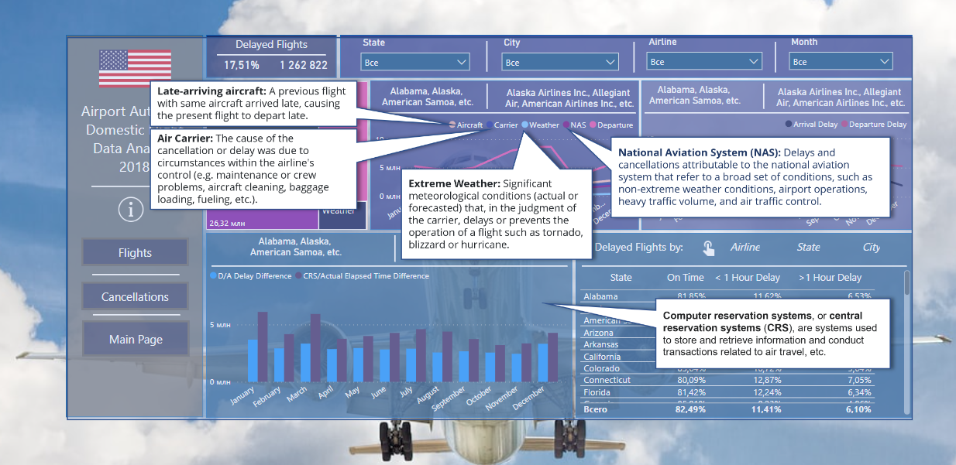
Notes:
Providing reference Information on delays page with additional image and bookmark.

Slide 6
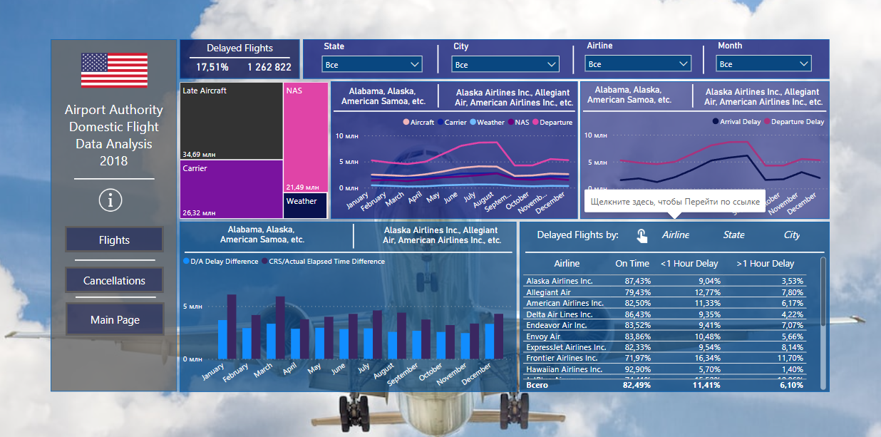
Notes:
Delays page with table visual displaying airline data – using bookmark.

Slide 7
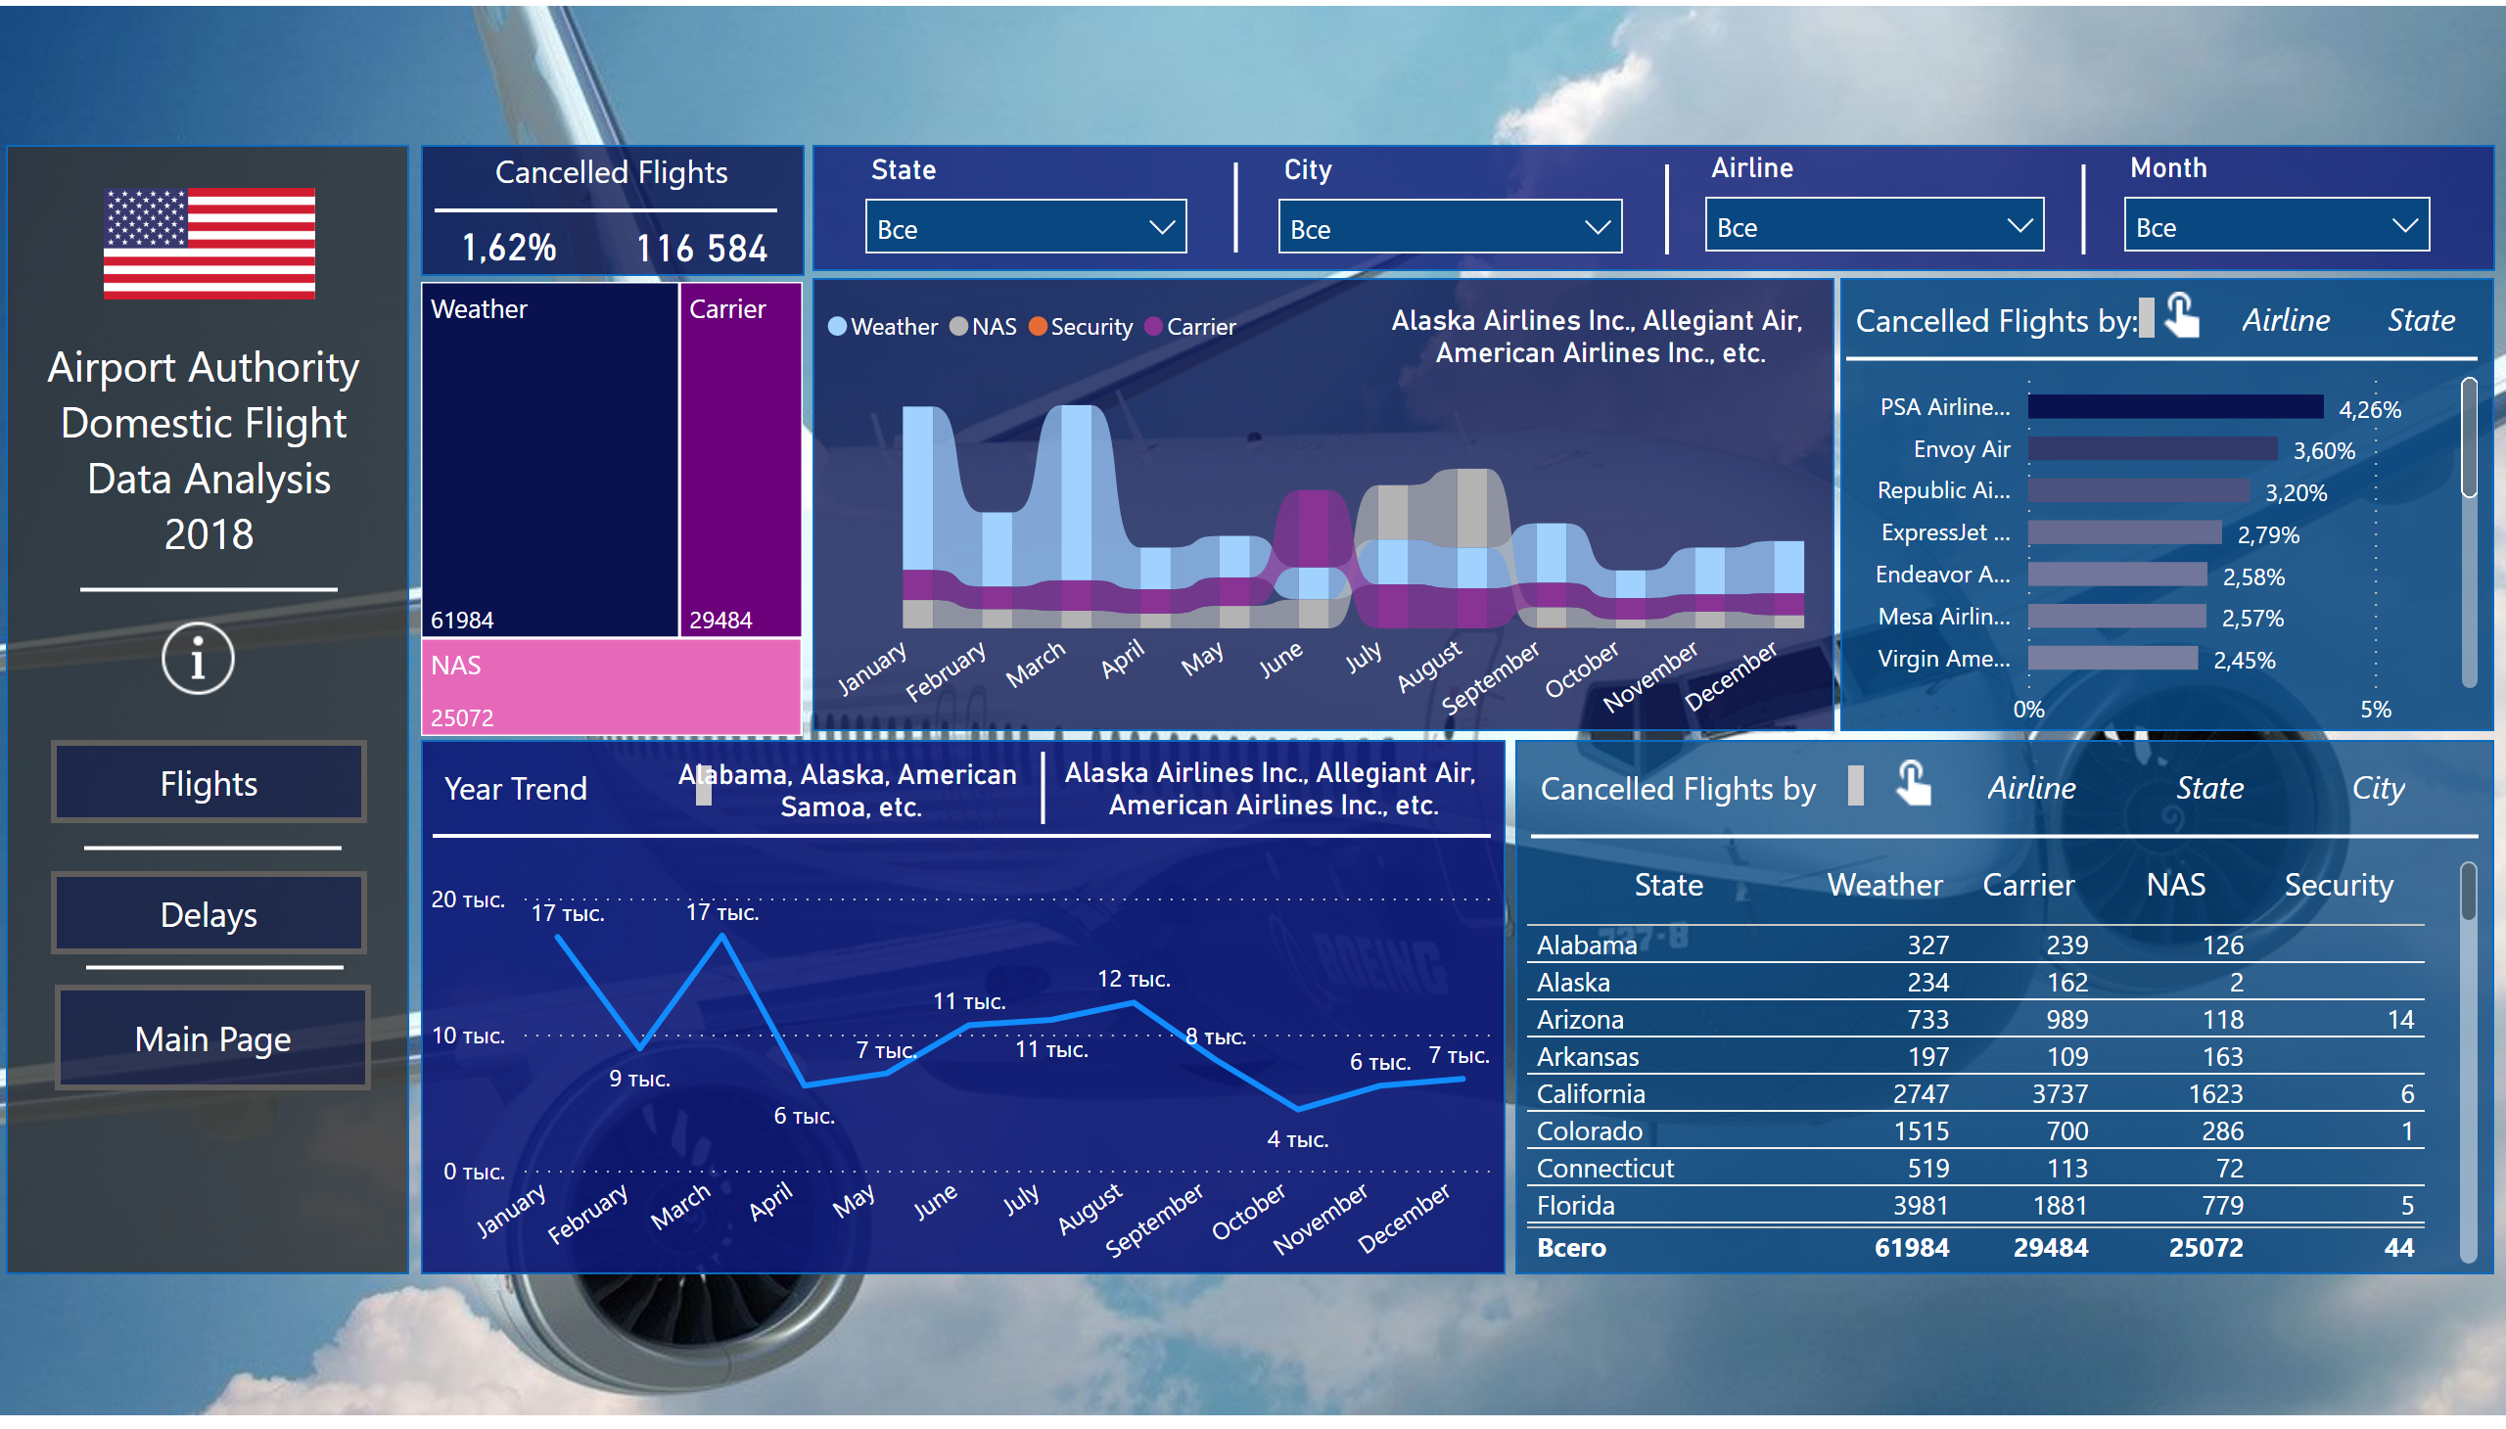
Cancellation Analysis
Notes:
Reasons of Cancellation
No alt text provided
shape
No alt text provided
lineChart
No alt text provided
shape
No alt text provided
textbox
No alt text provided
image
No alt text provided
actionButton
No alt text provided
actionButton
No alt text provided
shape
No alt text provided
actionButton
No alt text provided
shape
No alt text provided
shape
No alt text provided
shape
No alt text provided
card
No alt text provided
shape
No alt text provided
slicer
No alt text provided
slicer
No alt text provided
slicer
No alt text provided
card
No alt text provided
textbox
No alt text provided
shape
No alt text provided
shape
No alt text provided
barChart
No alt text provided
textbox
No alt text provided
Airline
No alt text provided
Button State 1
No alt text provided
shape
No alt text provided
tableEx
No alt text provided
textbox
No alt text provided
textbox
No alt text provided
shape
No alt text provided
shape
No alt text provided
barChart
No alt text provided
card
No alt text provided
shape
No alt text provided
shape
No alt text provided
slicer
No alt text provided
shape
No alt text provided
shape
No alt text provided
ribbonChart
No alt text provided
card
No alt text provided
State Table
No alt text provided
tableEx
No alt text provided
Button State
No alt text provided
Button City
No alt text provided
Button Airline 1
No alt text provided
card
No alt text provided
shape
No alt text provided
shape
No alt text provided
image
No alt text provided
image
No alt text provided
image
No alt text provided
image
No alt text provided

